Slide 1
A Hybrid Machine Learning System for Stock Machine Market Forecasting
Proceedings of world academy of science, engineering and technology volume 29 May 2008 ISSN 1307-6884
Rohit Choudhry, and Kumkum Garg
Presenter: Tsung-Jung Tsai (蔡宗容)
Date: Aug 20, 2008

Slide 2
Abstract (1/2)
In this paper, we propose a hybrid machine learning system based on genetic algorithm and support vector machines (SVM) for stock market prediction. A variety of indicators from the technical analysis field of study are used as input features. We also make use of correlation between stock prices of different companies to forecast the price of a stock, making use of technical indicators of highly correlated stocks, not only the stock to be predicted.

Slide 3
Abstract (2/2)
The genetic algorithm is used to select the set of most informative input futures from among all the technical indicators. The result shows that the hybrid GA-SVM system outperforms the stand alone SVM system.

Slide 4
SVM - Training
class
features
0
1
1
0
1
SVM
Black box
Model

Slide 5
SVM - Prediction
class
features
Model
1
1
1
0
0
SVM
Black box
class
features
1
0
1
1
0

Slide 6
The stock direction prediction problem
Is modeled as a two class classification problem.
The directions are categorized as 0 & 1.
  0 means that the present day’s price is less than the previous day.
  1 means that the present day’s price is more than the previous day.

Slide 7
Proposed system – Data source
Choose the Indian stock market
We have chosen 3 stocks:
  Tata consultancy services (TCS)
  Infosys
  Reliance industries limited (RIL)
There are the most prominent stocks on India’s stock exchange.

Slide 8
Proposed system –
Correlation between stocks
Studies have shown that the price of a stock does not move in isolation.
Price movements in one stock can often be used to predict the movement of other stocks.

Slide 9
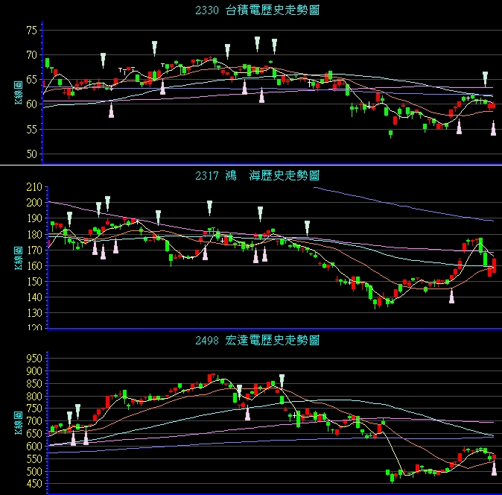

Slide 10
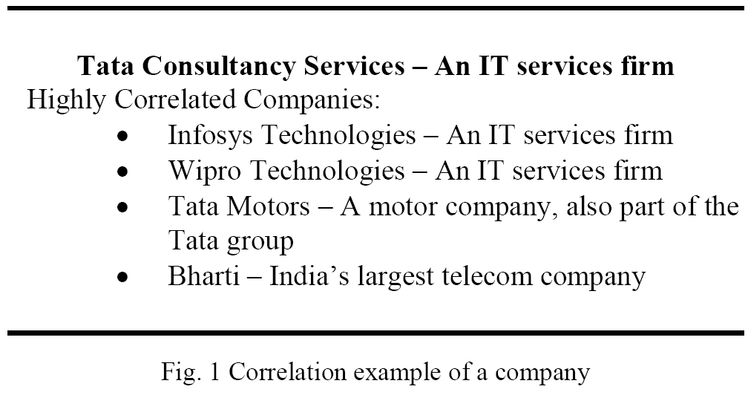
Proposed system – correlation between stocks

Slide 11
Proposed system – Input features
We use a set of 35 such technical indicators as candidates for input features.
We first find the m companies which exhibit the highest correlation with the stock to be predicted.
We obtain a set of 35 * m candidate features.

Slide 12
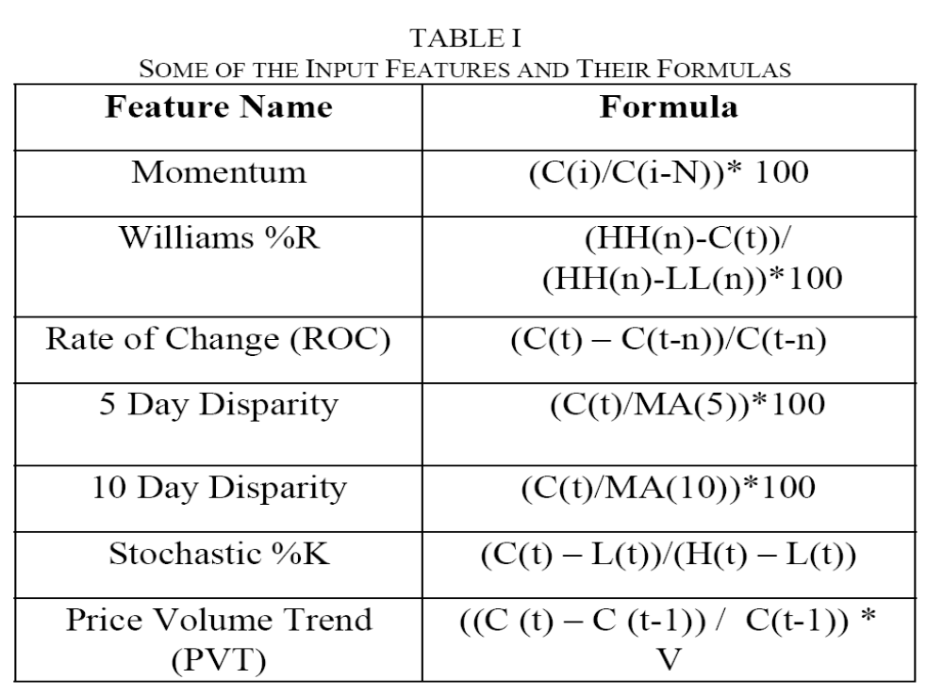
Proposed system – Input features

Slide 13
Proposed system –
Genetic Algorithm
Representation:
  We represent a chromosome by a binary vector of size 35 * m, where each bit of the chromosome tells whether the corresponding input feature is selected or not.
…

Slide 14
Proposed system –
Genetic Algorithm
Fitness evaluation:
Where A(i) is the classification accuracy obtained by the SVM with the input feature set as described by chromosome I
And AR is the accuracy of a random guess, which in this case is 0.5.

Slide 15
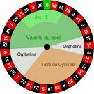
Proposed system –
Genetic Algorithm
Selection:
  Roulette Wheel selection (轉輪法) is used for parent selection.
  Thus, chromosome with high fitness scores get selected more often.
The i_{th} probabilistic for choice:
fitness(i) / sum(fitness)

Slide 16
Proposed system –
Genetic Algorithm
Crossover and mutation are then carried out to produce a new generation.
Stopping condition:
  The GA stops when it does not find a better solution for a fixed number of generations.

Slide 17
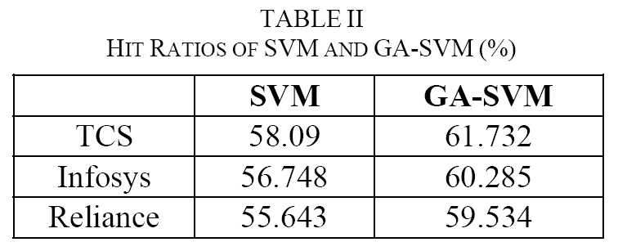
Experimental results

